Slide 1
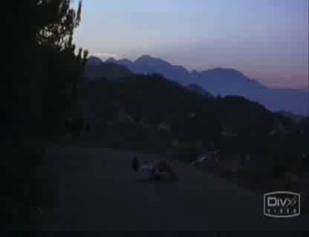
Close your eyes…
Share…
Pair…
Think…
How could so many people have died?
How could so many people have died?
How could so many people have died?

Slide 2
How could so many people have died?

Slide 3
The Black Death
Europe, 1347-1351
Reached England in 1348
Killed around one third of the population
Biggest disaster since the Ice Age

Slide 4
Why did the Black Death kill so many people?
To know what the Black Death was and how it spread
To use sources to find out about the symptoms

Slide 5
Source
“Its earliest symptom was the appearance of fierce swellings in the groin or the armpit, some of which were egg-shaped whilst others were roughly the size of a common apple. People have called these swellings Buboes. By the second day, the victim would violently cough and vomit blood. The following day people have been known to find dark blotches and bruises under their skin, sometimes very large. If the victim was still alive, they could be seen shaking uncontrollably in their beds, screaming to God for relief. By the fifth day, God would finally show his mercy. The swellings might release a foul stench and dark liquid, which would sometimes mean the victim had been spared. But most times death would come swiftly, ending the endless pain and releasing his soul to God’s will.”

Slide 6
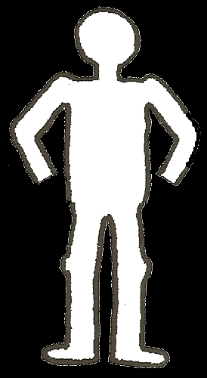
Task 1
Read through the symptoms source
Extract a quote for each day showing the symptoms, writing them in the flowchart boxes
Draw these symptoms onto your blank body
If you finish early: Write out a short description IN YOUR OWN WORDS about what happens
1.
2.
5.
4.
3.

Slide 7
Source
“Its earliest symptom was the appearance of fierce swellings in the groin or the armpit, some of which were egg-shaped whilst others were roughly the size of a common apple. People have called these swellings Buboes. By the second day, the victim would violently cough and vomit blood. The following day people have been known to find dark blotches and bruises under their skin, sometimes very large. If the victim was still alive, they could be seen shaking uncontrollably in their beds, screaming to God for relief. By the fifth day, God would finally show his mercy. The swellings might release a foul stench and dark liquid, which would sometimes mean the victim had been spared. But most times death would come swiftly, ending the endless pain and releasing his soul to God’s will.”
fierce swellings in the
groin or the armpit

Slide 8
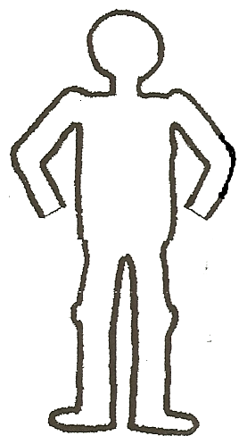
1.
2.
5.
4.
3.
“fierce swellings in the
groin or armpit”

Slide 9
Task 1
Read through the symptoms source
Extract a quote for each day, writing them in the flowchart boxes
Draw these symptoms onto your blank body
If you finish early: Write out a short description IN YOUR OWN WORDS about what happens
1.
2.
5.
4.
3.

Slide 10
1.
2.
5.
4.
3.
“fierce swellings in the
groin or armpit”

Slide 11
One sentence…
Write down one reason from the evidence we have just looked at explaining why the Black Death killed so many people
Use a quote in your sentence if you can
Sentence starter
The Black Death killed so many people because…

Slide 12
Black Death Symptoms…
In your table groups
Prepare a short re-enactment of the symptoms of the Black Death
Remember there are FIVE stages – make sure you include them all!

Slide 13
The Symptoms Be ready to act out all of the 5 main stages of the Black Death in your groups!

Slide 14
Black Death Storyboard
Create a storyboard about the Black Death
It must include:
Causes of the disease
How it spread
Symptoms
Plan in your books first – 9 sections
Think carefully about what images and writing to include
Need to understand it as you will need to use it to prepare for your assessment in a few weeks!

Slide 15
Storyboard: The Black Death

Slide 16
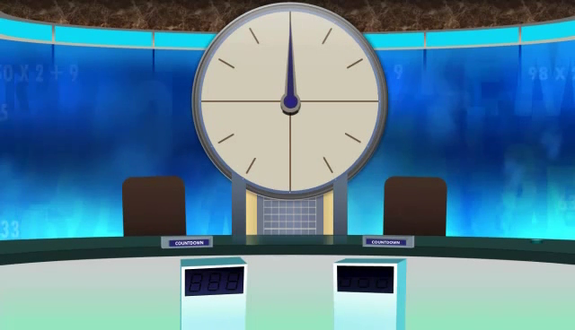
GELPUA
PLAGUE

Slide 17
MITOV
VOMIT

Slide 18
SYMPTOM
MYMSPOT

Slide 19
TELPANS
PLANETS

Slide 20
BLEEDING
DEBLENGI

